Slide 1
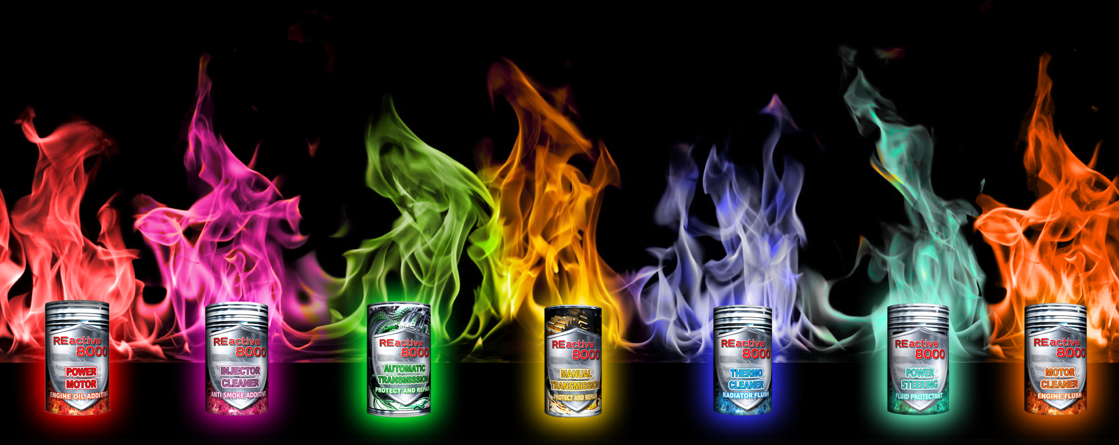
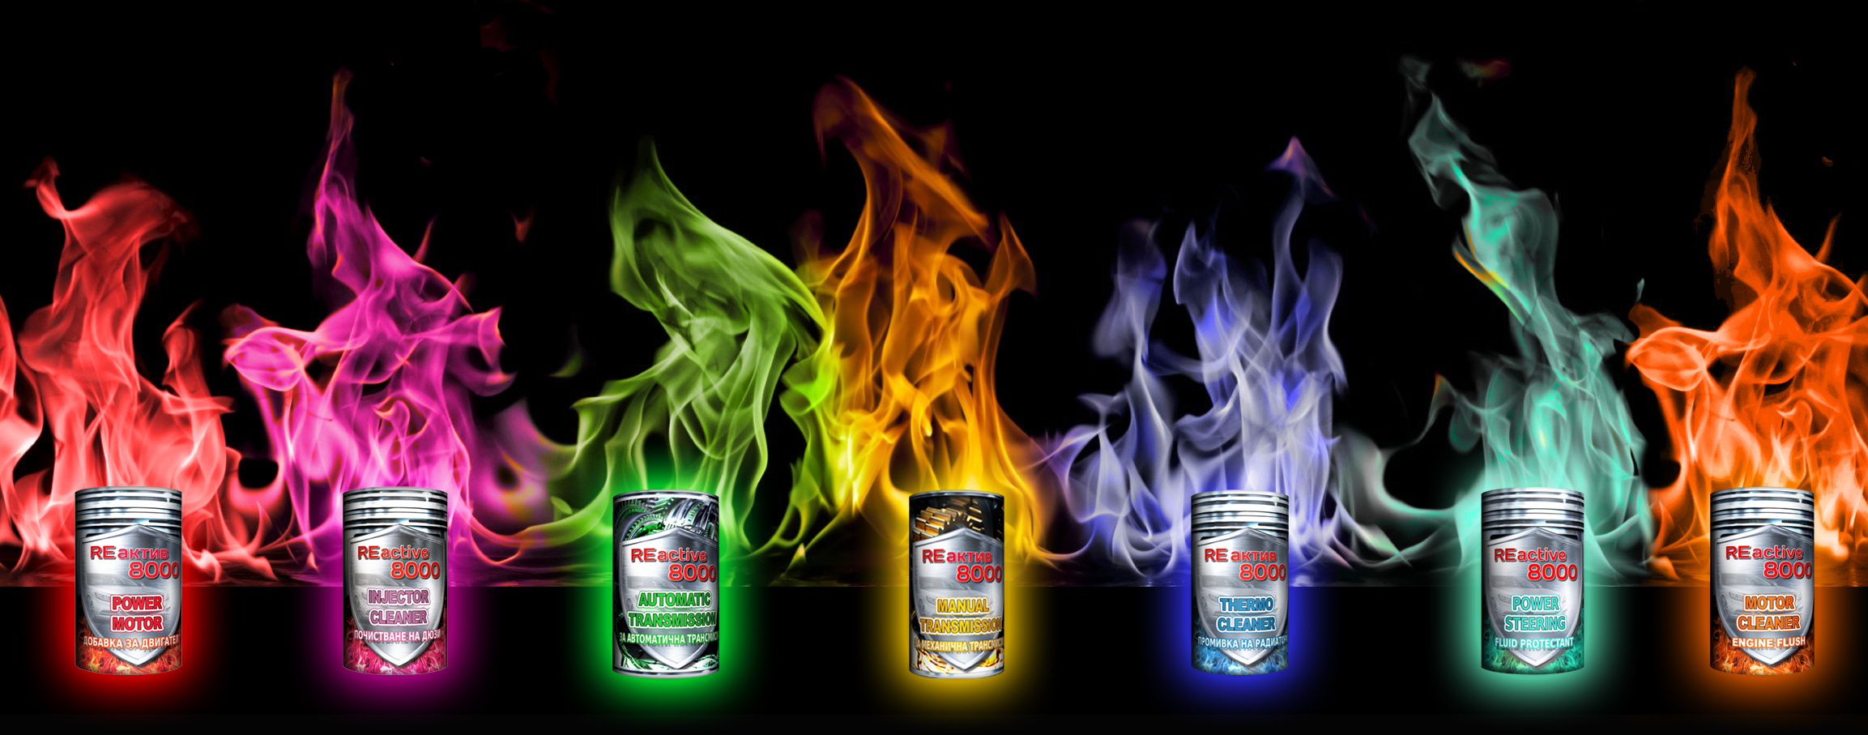
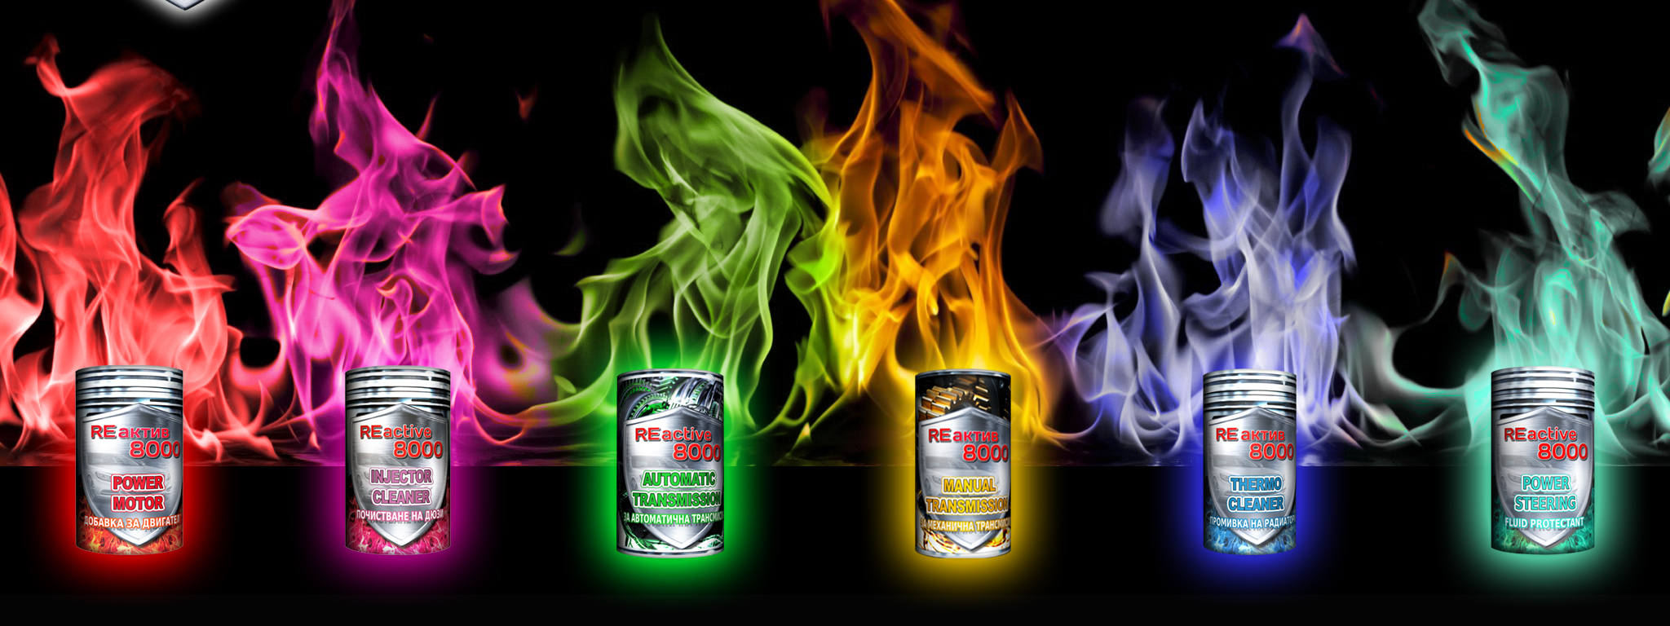

REACTIVE 8000
a unique franchise for the online store of new generation auto additives

Slide 2
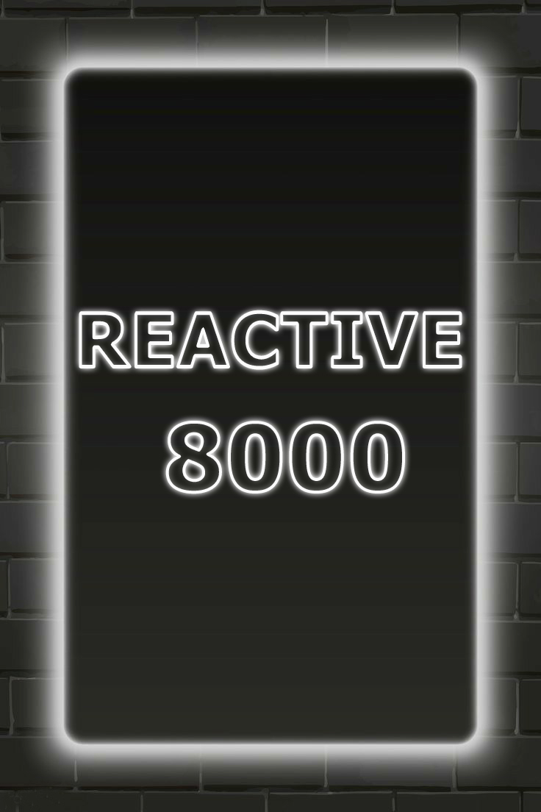
About the brand
The world leader in the production and distribution of REACTIVE 8000 has existed since 1995, and since 2001 has been actively developing a network of online and offline stores.
Today, the brand is represented in 16 countries. The popularity of the REACTIVE 8000 brand, impeccable quality, a wide range of products, a high level of loyalty among drivers this allows our online stores to constantly develop and generate a profit stream.

Slide 3

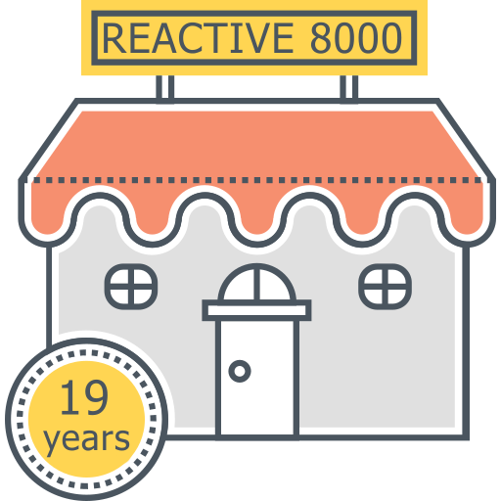
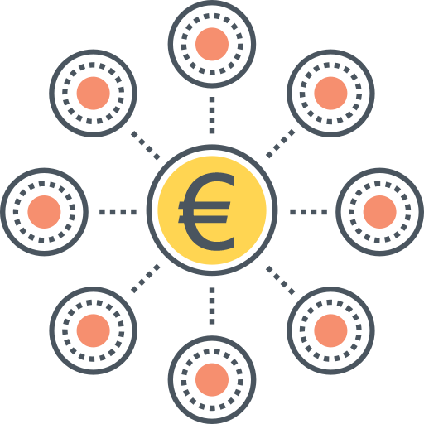


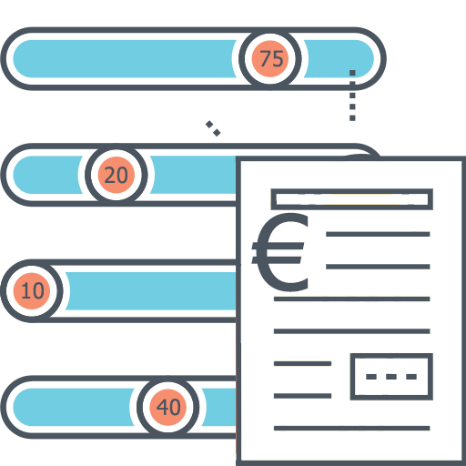
FACTS AND FIGURES
19 years
More than 19 years on the European market
€ 24 000
More than € 24,000 average annual profit of the franchisee
70 %
More than 70% of buyers return for a second purchase and become regular customers
€ 1,5 million
More than € 1.5 million annual turnover of the REACTIVE 8000 group of companies
€ 20-30
Average bill € 20-30

Slide 4

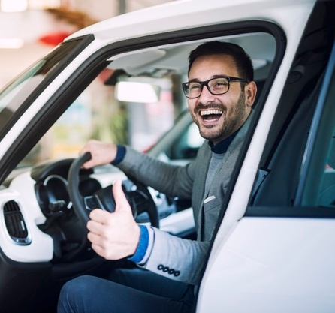
OUR customers
All car owners who care about the condition of their car, and who want to extend the service life and maintenance-free period
Car owners who have purchased a used car and are unsure of the quality of consumables and the level of care for the car by the previous owner.
Car owners who bought a new car in the salon and want to protect it from not always high quality oil and fuel sold in Europe.
Car owners of old diesel cars who want to get an environmental sticker EURO 5 and permission to use the car in Europe for a long time.
Car owners who care about the environment and strive to minimize the harmful effects of the car on nature.
Auto repair shops and service station owners.
Used car website owners who want to hide or quickly eliminate some noticeable negative parameters of the cars they sell (oil leaks, heavy smoke from the exhaust, difficulties in ignition, engine noise, etc.)

Slide 5
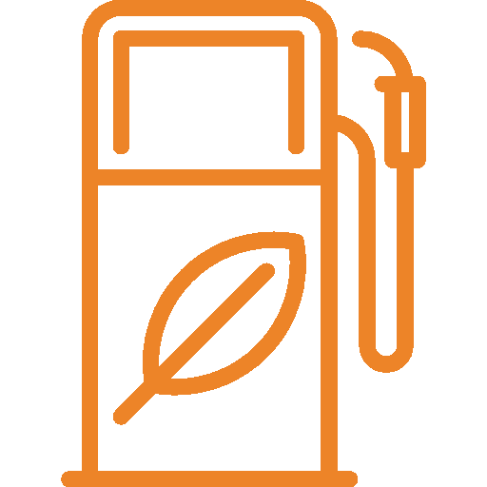

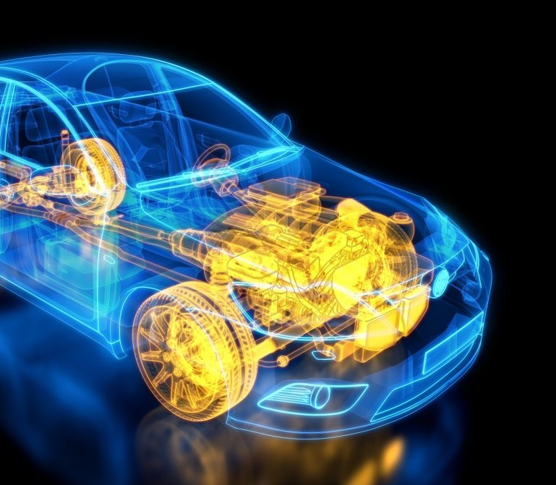




Assortment structure
REACTIVE 8000 offers:
Fuel additive
Additive for cleaning car systems
Oil additive
Radiator additive
Additive for gearboxes
Power steering additive

Slide 6



World Exclusive
Only the company REACTIVE 8000 produces auto additives containing platinum components that restore the structure of the metal at the chemical level. Therefore, the products of the company REACTIVE 8000 are the fastest-acting additives and have the longest-lasting effect.
Only our partners who have exclusive contracts have the right to sell and distribute our products.

Slide 7








Choose the best
The REACTIVE 8000 franchise will fit perfectly into your business portfolio, regardless of what you are currently doing:
The franchisee support program includes complete support for your website, social networks, and trade marketing. We fully support our partners at all stages of building a business and further expansion. We are interested in your development!
Extensive experience in the development of regional networks - the best support in the business under construction.
The store's assortment consists of the most popular and famous products with high profitability.
Regular training modules will allow you to develop and optimize all business processes, our consultants answer all questions 24/7.
Automation of order processing and sending them to customers takes a minimum of time.
The rates and budgets of the advertising campaign are regulated by analysts 24/7 and bring partners the maximum result.
Advertising is launched on all social media marketing channels and is presented in all formats. Advertising creatives are created, tested and launched by a team of professionals.

Slide 8
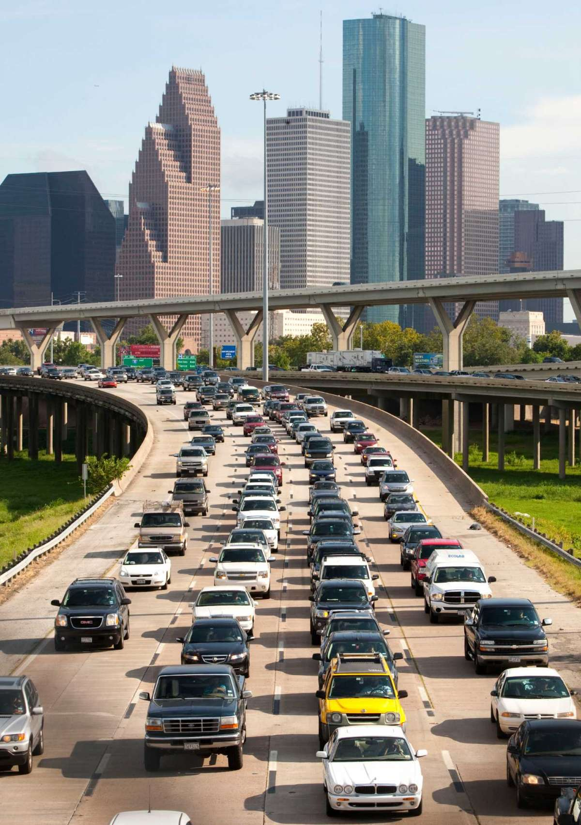

Promotion Features
The consumer demand for auto additives is year-round and does not depend on the seasons.
There are more and more cars, respectively, the demand for products is constantly growing.
Pandemics, trade stagnation and crises always contribute to the activation of online commerce, so now is the best time to start with an e-store franchise!
A wide assortment satisfies the needs of all drivers, regardless of the existing problems in the car.
Prices for additives are very low compared to the cost of car maintenance and repairs, which makes the purchase of additives a priority.
Laws aimed at combating harmful emissions and banning diesel cars without environmental stickers also contribute to an increase in demand for REACTIVE 8000 products, as it reduces the pollution of nature by exhaust gases at times, and regular use of additives leads to hassle-free receipt of the sticker of EURO 5-6 and passing of technical inspection.

Slide 9







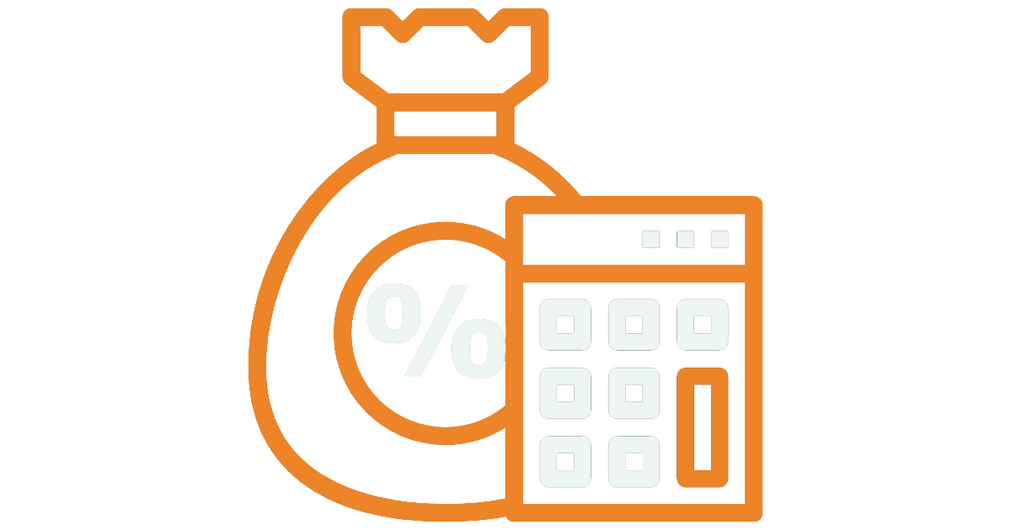
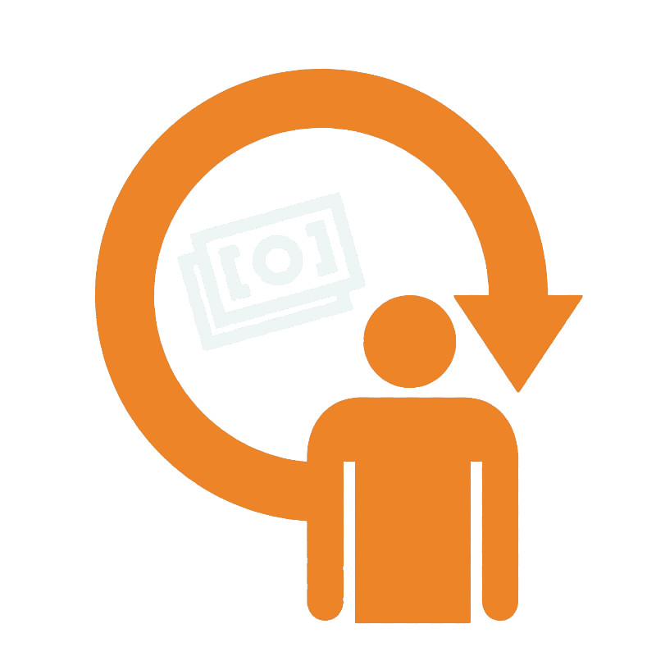
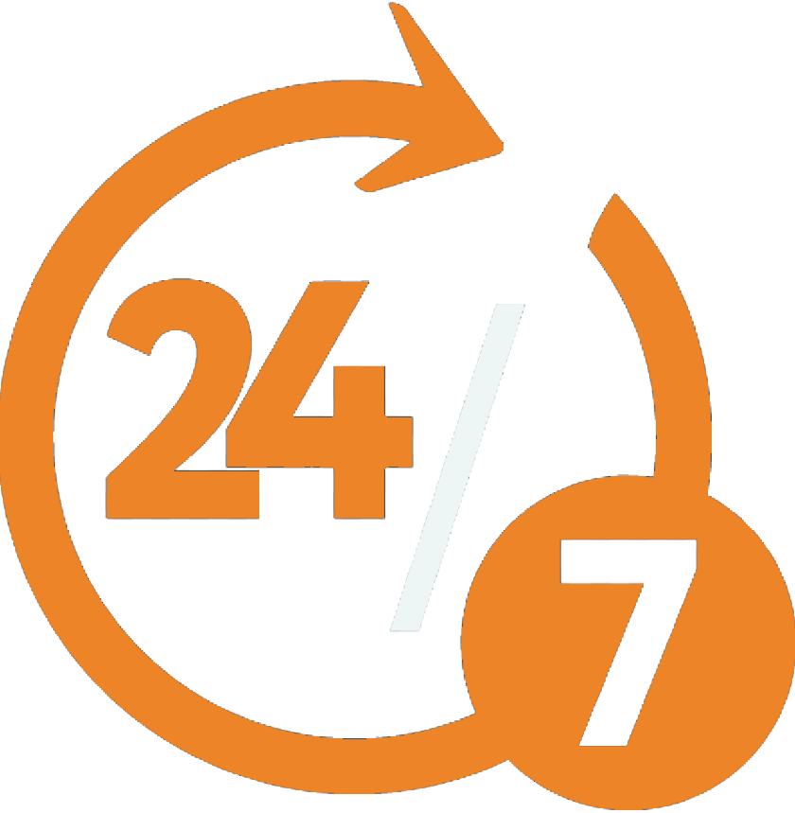
Competitive advantages
Profitability 30%
Royalties 2.9-3.1 % of turnover
Full management of all advertising campaigns by our specialists
Optimization of the franchise business model for exclusive trade in the region
Good reputation and high brand awareness, always satisfied customers, with whom it is pleasant to communicate
Average margin 250-320%
Return on investment 3-4 months
24/7 technical support

Slide 10



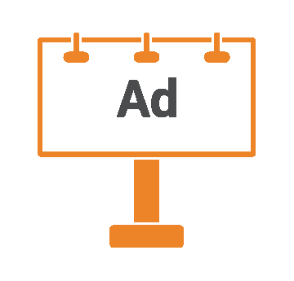




We are doing everything to make the reactive 8000 successful in every country
We maintain, update and optimize the store's website | We teach and support you and your employees | We fully maintain, update, analyze and regulate advertising | We advise on operational issues
We control the quality and timeliness of the delivered products | We form a basic order for the fastest possible return of working capital | We develop an individual program of trade marketing activity

Slide 11

8 steps of starting your own business
Cooperation negotiations
Launch of your website, Facebook page, business modules
Optimization of systems for sending orders and receiving payments to your bank account
Signing of a commercial concession agreement and a supply agreement
Creating a primary order
Training
Launching an ad campaign
Bottom line: You are the owner of a profitable business
Creating a continuous, round-the-clock flow of customers and making a profit

Slide 12

Working in a non-competitive niche of trading exclusive auto additives allows you to make a margin
of 200 to 289 %.
Below is a table of wholesale and recommended retail prices.
Name of the additive | Wholesale price for partners, € | Retail price in the online store, € | Trade margin
Injector Cleaner | 3,3 | 6,7 | 203 %
Power Motor | 5,9 | 12,1 | 205 %
Activator+ | 9 | 26 | 289 %
Activator | 5,4 | 14,4 | 267%
Pro-active | 5 | 11,1 | 222%
Thermo Cleaner | 4 | 10 | 250 %
Manual Transmission | 4,9 | 12,1 | 247 %
Automatical Transmission | 5,3 | 13,3 | 251 %
Motor Cleaner | 3,3 | 6,7 | 203 %
Power Steering | 4 | 10 | 250 %
FINANCIAL INDICATORS

Slide 13


THUS, let's briefly analyze the main financial model of generating profit for partners of the Reactive 8000 company
Region with population |  | ≈ 8 million
Average monthly turnover through the online store |  | from 800 units and more
Average product price |  | ≈ 8 €
With an average margin |  | 250 %
The turnover of the product is |  | min from 6400 €
Profit |  | min from 3840 €
Net of operating expenses and taxes Net profit |  | from 2000-2500 € in month

Slide 14
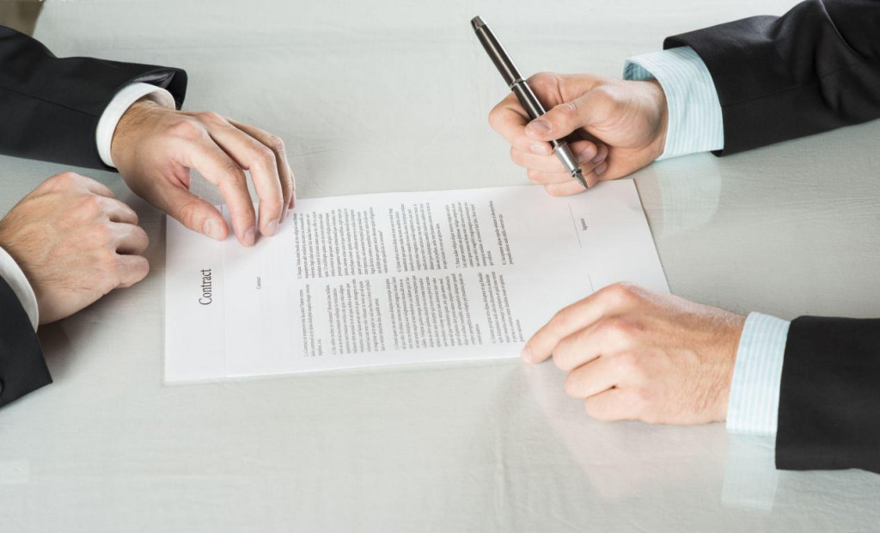


Conditions for launching a franchise
TO LAUNCH A FRANCHISE
LAUNCH DEADLINE
Choose a region with a population of at least 8 million people, in which you are the exclusive representative of the brand REACTIVE 8000
The business start - up period is 1 month, from the date of signing the contract and payment of the initial franchise package, which also includes the basic purchase of goods

Slide 15

WE WILL BE GLAD TO SEE YOU AMONG OUR PARTNERS!!!
INFO@REACTIVE-8000.COM

