Slide 1
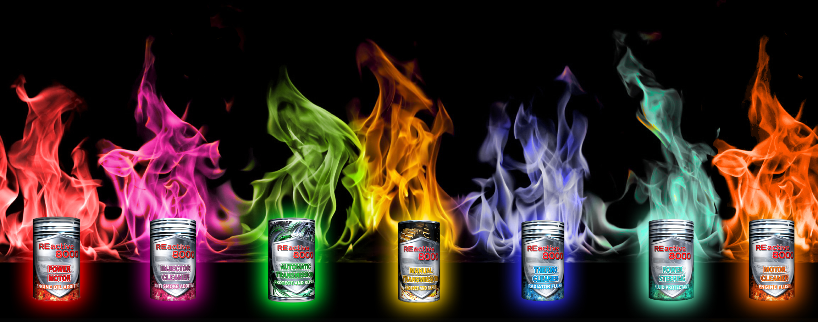

REACTIVE 8000
financial indicators

Slide 2




3 franchise options
STANDART
amount of all investments
(include goods)
€ 3200
BUSINESS
amount of all investments
(include goods)
€ 3950
GOLD
amount of all investments
(include goods)
€ 4700
What does the cost of each franchise include?

Slide 3

Let's take a look at what these investments consist of:
The price of any package includes:
Lump-sum payment
Online store
Purchase of products
Royalty
We will consider each component in more detail below.

Slide 4
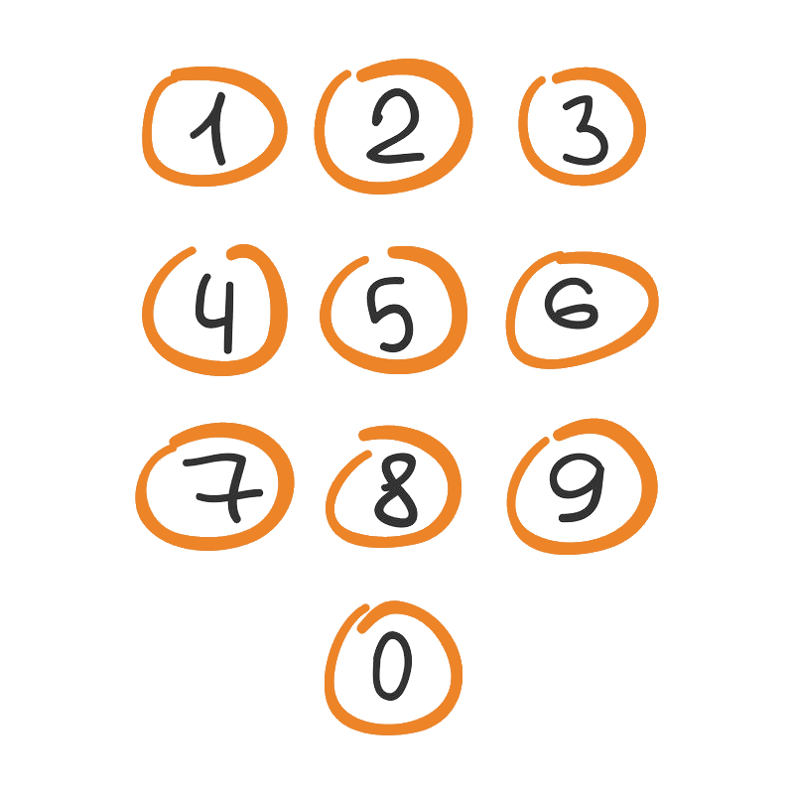

lump-sum payment
STANDART | BUSINESS | GOLD
700 € | 500 € | 300 €
We sign an agreement for exclusive cooperation in a territory with a population of at least 8 million people.
At this stage, our specialists create for your business:
domain name
connect hosting
create a Facebook page + Facebook business manager
video advertising creatives and slogans
set up audience targeting to show ads in the selected region to the most relevant segment of the population with the highest buying power.
A database of potential customers is being collected to fine-tune the display of ads and achieve maximum results.
We translate all materials into the local language and, in agreement with you, make stylistic adjustments to the text part for more accurate transmission.

Slide 5

online store
STANDART | BUSINESS | GOLD
1500 € | 1450 € | 1400 €
Our specialists fully configure and adapt your future online store to work.
Created: :
work mail
order processing modules
SEO is adjusted based on the characteristics of the region of your work
the site is being filled with products and articles
We teach you to use the admin panel of the store for full control on your part.
The store is connected to the domain name and is ready to work!

Slide 6
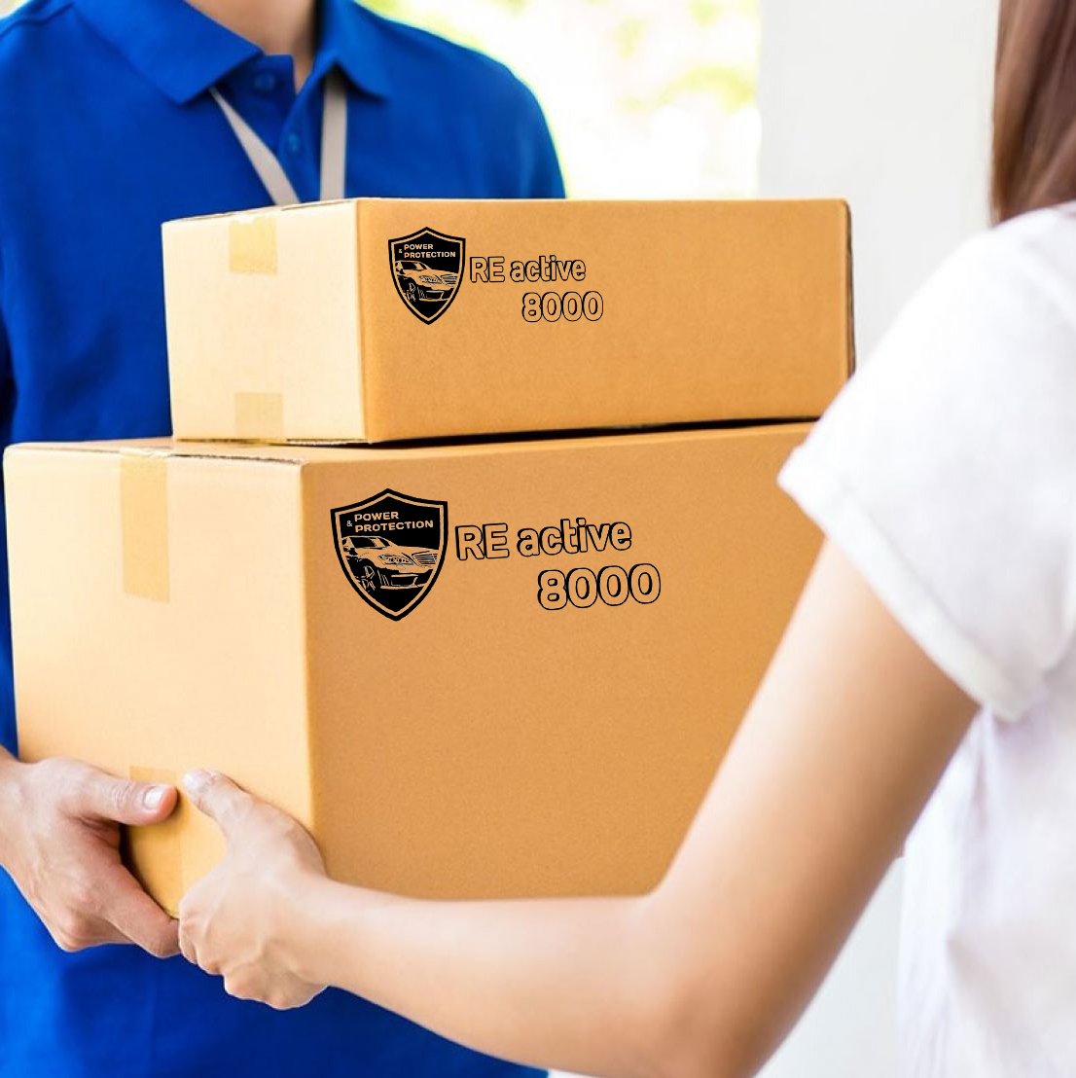
purchase of products
STANDART | BUSINESS | GOLD
1000 € | 2000 € | 3000 €
The primary purchase of products is made for the specified amount. Further purchase of products is made as needed in the amount of 1000 €.
The assortment of the primary purchase is formed from the most popular and demanded products for the fastest payback.
Exclusive wholesale prices from the manufacturer.
Recommended selling prices in the online store.
Additive name | Wholesale price for partners, € | Retail price in the online store, € | Trade margin
Injector Cleaner | 3,3 | 6,7 | 203 %
Power Motor | 5,9 | 12,1 | 205 %
Activator+ | 9 | 26 | 289 %
Activator | 5,4 | 14,4 | 267%
Pro-active | 5 | 11,1 | 222%
Thermo Cleaner | 4 | 10 | 250 %
Manual Transmission | 4,9 | 12,1 | 247 %
Automatical Transmission | 5,3 | 13,3 | 251 %
Motor Cleaner | 3,3 | 6,7 | 203 %
Power Steering | 4 | 10 | 250 %

Slide 7

royalty
STANDART | BUSINESS | GOLD
3,1 % | 3 % | 2,9 %
This is a percentage of the turnover of goods that you pay monthly to the head office of the company.
The company charges royalty for:
exclusive representation in the region
daily professional support
constant updating of content and printed materials
training
Thus, if your turnover was 10,000 euros per month, the royalties will be only from 290 to 310 euros, depending on the package you choose.
Thanks to the work under the franchise agreement, there will be no competition on your territory!

Slide 8

Advantages
Working with us, you get a lot of advantages, namely:
You do not need to look for a room for a store, everything is organized online. Therefore, you can control the entire process remotely and there are no rental, repair and equipment costs.
The products are so compact that you will not need to rent a warehouse or a room for storing goods. All the goods take up a little space and can be stored even in your apartment.
You do not need to hire a large staff of employees, pay large taxes and wages, you can easily cope with this matter or just one hired employee who will carry out direct activities.
Business with the REACTIVE 8000 can be combined with your main job or business, since your time costs will be no more than 2 hours a day.

Slide 9

Results
 | STANDART | BUSINESS | GOLD
Lump-sum payment | 700 € | 500 € | 300 €
Online store | 1500 € | 1450 € | 1400 €
Purchase of products | 1000 € | 2000 € | 3000 €
Royalty | 3,1 % | 3 % | 2,9 %
TOTAL | 3200 € | 3950 € | 4700 €
The total amount of all primary investments is indicated, while you already have a working website, the required product and the entire advertising campaign configured and ready to launch.
You just need to choose which of the packages is preferable for you and you can work!
Based on the population, the number of partners is calculated, each of which exclusively works in a territory with a population of at least 8 million people.
The rights to the region are closed when signing the contract and paying the primary payment. You work without competition in your region.

Slide 10

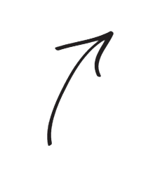



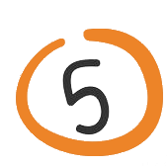
Scheme of work
On your work mail you receive orders from clients made on your website or on Facebook.
You process the received orders. You call customers to get additional information about the order, as well as for the opportunity to increase the cost of the order by offering related products to the customer.
You collect, execute and prepare for shipment all received orders for the day.
On the same day, you send all prepared customer orders by courier service (for example, FAN COURIER, etc.)
The client receives his goods, pays for the delivery of the goods and the goods themselves at the courier service office.
You receive money for the goods to your bank account, since the goods are paid by cash on delivery, or you can receive cash at the courier service office.

Slide 11

What’s next?
We continue to adjust, update and customize the ad campaign, adjust bids and audience targeting, create new video and audio ads, creatives and posts.
We periodically teach you the specifics of work to increase your profits and maximize all business processes.
We supply you with all products as required.
We support you 24/7.
We are primarily interested in your development and maximum profit.
Together with the franchisee, we always achieve the best results !!!

Slide 12

WE WILL BE GLAD TO SEE YOU AMONG OUR PARTNERS!!!
If you have a desire to become a partner and start earning with the company REACTIVE 8000, we will be glad to start a productive and mutually beneficial cooperation with you!
If you have any questions, we will be happy to answer them.
INFO@REACTIVE-8000.COM

